Slide 1
ENHANCING YOUR DATA
HSBC Tech Apprentices Programme
2023

Slide 2

agenda
Topic one
To Start: a Handy Hack
On the Input Side: Data Validation
On the Output Side, 1: Conditional Formatting
On the Output Side, 2: Sparklines and Other Tricks
Exercises
Image generated by Dall-E

Slide 3
To Start: a Handy Hack

Slide 4

TO START: A HANDY HACK
A large part of working with data is enrichment: adding columns to a dataset – typically using formulae – to turn the data we have into the data we actually need.
Formulae, though, can be fragile. If you add more columns or rows to the set, it may break existing references. Also, when copying/pasting into other worksheets, formula references either won’t survive the transition, or will become cumbersome to read/manage.
Fortunately, help is at hand – a keyboard shortcut you may not be familiar with …
Image generated by Dall-E

Slide 5
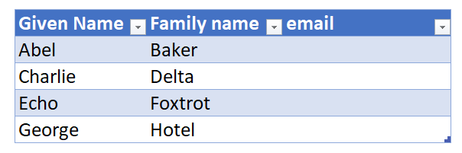
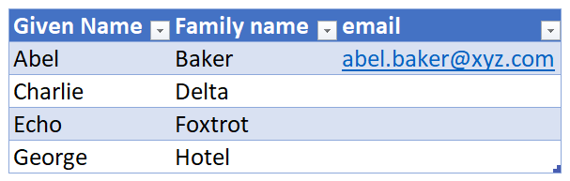
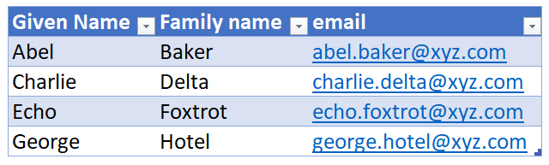
The CTRL-E autofill shortcut
Say you have a list of given names and family names, and your task is to generate email addresses.
Sure, it can be done with string formulas, regular expressions and so on – but there’s a much easier way:
1
Set up your data table with an extra column
2
Type in the first value, showing Excel the pattern you want replicated
3
Select the cell below the one you modified in step 2, and press CTRL-E. Satisfying!
Notes:
The spreadsheet has this example so you can walk through

Slide 6
ON THE INPUT SIDE: DATA VALIDATION

Slide 7
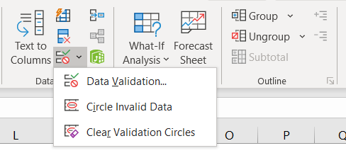
The data tab, and data tools
Find the Data Tools group to the right hand side of the Data tab. Data validation is used to:
Find or eliminate duplicate values
Highlight empty cells
Prevent out-of-range (e.g. negative) values
Enforce correctly-formed input (e.g. email addresses, dates)
Add interactive features such as drop-down menus to eliminate input error and facilitate navigation
Notes:
An Excel spreadsheet is a large flexible grid that is used to store, modify and analyse information.
This data is typically numerical, but can also be things like text, dates, chart objects etc.
In Excel, data is stored in a worksheet, which is made up of rows (1) and columns (2). The intersection of a row and column is called a cell (3), and can contain may types of data.

Slide 8
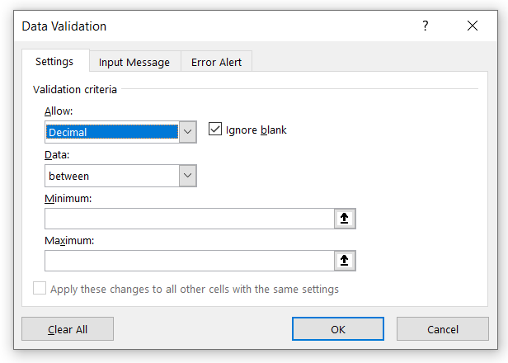
THE VALIDATION DIALOG
Settings
1
Choose the validation type in the Allow field.
2
In the Data field, define a range. Options include:
Equals
Less than
Greater than or equal to
3
Choose to ignore blanks, or enforce non-null values

Slide 9
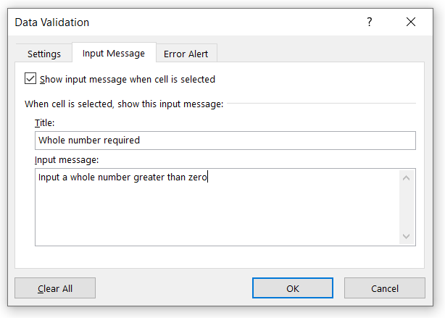
THE VALIDATION DIALOG
Input Message
1
Choose whether to show an input message (default: yes)
2
Set the title and text of the input message popup.

Slide 10
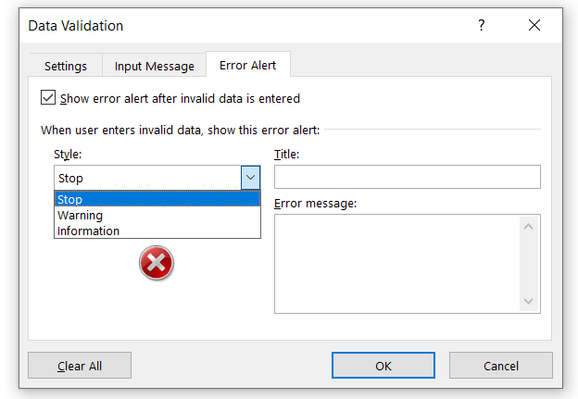
THE VALIDATION DIALOG
Error Alert
1
Choose whether to show error message (default: yes)
2
Set the icon style, title and text of the error alert popup.

Slide 11
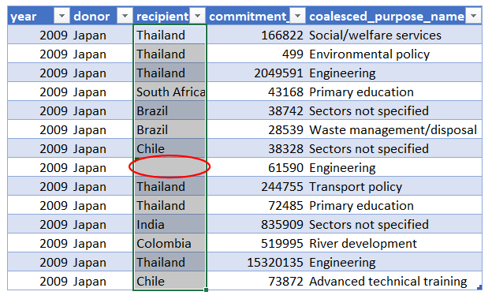
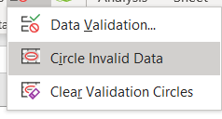
Applying a data validation rule
Circle missing values in a table using the following process:
1
Choose whether to show error message (default: yes)
2
In Settings, define a field with a text length of greater than or equal to 1
3
From Data Tools > Validation, choose Circle Invalid Data
Notes:
Column: Vertical series of adjacent cells from top to bottom
Row: Horizontal series of cells from left to right
Cell: Intersection of a row and column
Active Cell: Cell that is currently selected
Cell range: Series or block of adjacent cells
This range here would be indicated as cell E5 to G7. So from the top left hand cell to the bottom righthand cell.

Slide 12
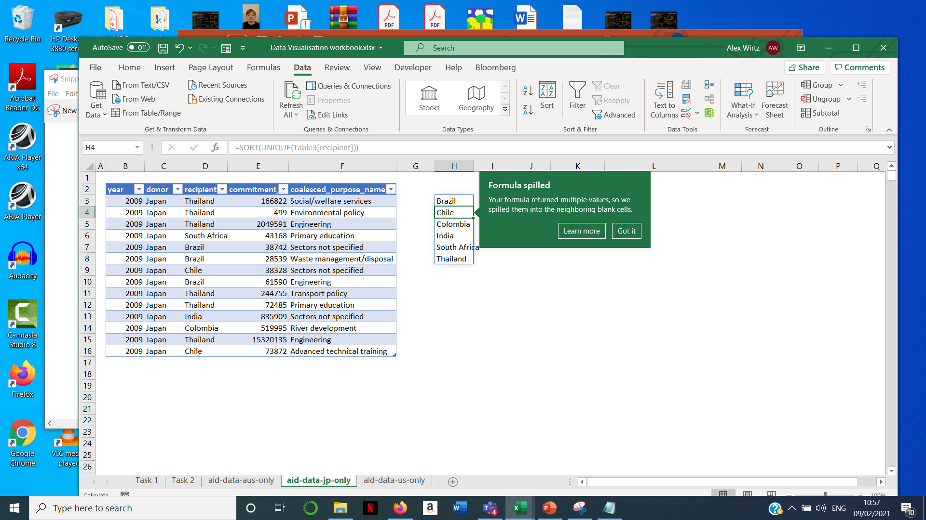
Using sort(unique) to create a dropdown menu
We want to convert the recipient column to dropdown values to prevent spelling mistakes or other errors when new data is input.
Notes:
1: Ribbon Interface
Displays tab commands organized into groups. If you click the different tabs, you will see the commands change. Notice that some of the commands might be grayed out. This is because those commands are only usable in certain situations. The File tab, which opens Backstage view, is also included here.
2: Tabs
Groups of similar commands are organized under tab names. Click a tab to view the commands in the ribbon.
3: Quick Access Toolbar
As the name implies, the Quick Access toolbar gives you quick access to frequently used commands. This toolbar is completely customizable and can be positioned above or below the ribbon commands.
4: Name Box
Every cell has a name in the format “ColumnRow”. The name of the currently selected cell, called the active cell, is shown in the Name Box. In the sample image, the active cell is A1.
5: Formula Bar
The Formula Bar allows you to enter data in a cell. Data can be alphanumeric, pictures, symbols, or (as the name suggests) formulae.
6: Working Area
The data contained in the file will be shown here.
7: Worksheet Tabs
Every Excel file is properly referred to as a workbook. A workbook can contain one or more worksheets, just like an accounting ledger can contain one or more pages. Click these tabs to switch between the different worksheets.
8: Status Bar
This bar is used to display information about the workbook. Any running calculations will be shown here. There are also some zoom and view commands here.
9: Scroll Bars
As you grow more accustomed to working with Excel, you may begin to work on larger files. When all of the information in a worksheet will not fit on the screen, you can use these scroll bars to scroll horizontally or vertically through the data.

Slide 13
Using sort(unique) to create a dropdown menu
1
Use the SORT() function to return a list of permitted values. The source has duplicates – for our dropdown, we need unique values. The UNIQUE() function will help here. Put the following function in one cell:
=SORT(UNIQUE(Table3[recipient])).
2
As the list will be longer than one member, you will see this prompt. Make sure you have enough space to allow the formula to spill.
3
Name the range. I will call this range ‘Options’.

Slide 14
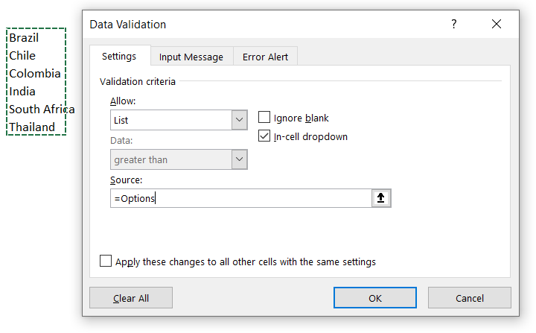
Using sort(unique) to create a dropdown menu
4
Select the recipient column, then go to the Data Validation dialog, where you will see the following:
5
Set the Validation criteria to List.
6
In the Source field, define the range of unique values using either the colon syntax or, as here, the named range.
Notes:
1: Ribbon Interface
Displays tab commands organized into groups. If you click the different tabs, you will see the commands change. Notice that some of the commands might be grayed out. This is because those commands are only usable in certain situations. The File tab, which opens Backstage view, is also included here.
2: Tabs
Groups of similar commands are organized under tab names. Click a tab to view the commands in the ribbon.
3: Quick Access Toolbar
As the name implies, the Quick Access toolbar gives you quick access to frequently used commands. This toolbar is completely customizable and can be positioned above or below the ribbon commands.
4: Name Box
Every cell has a name in the format “ColumnRow”. The name of the currently selected cell, called the active cell, is shown in the Name Box. In the sample image, the active cell is A1.
5: Formula Bar
The Formula Bar allows you to enter data in a cell. Data can be alphanumeric, pictures, symbols, or (as the name suggests) formulae.
6: Working Area
The data contained in the file will be shown here.
7: Worksheet Tabs
Every Excel file is properly referred to as a workbook. A workbook can contain one or more worksheets, just like an accounting ledger can contain one or more pages. Click these tabs to switch between the different worksheets.
8: Status Bar
This bar is used to display information about the workbook. Any running calculations will be shown here. There are also some zoom and view commands here.
9: Scroll Bars
As you grow more accustomed to working with Excel, you may begin to work on larger files. When all of the information in a worksheet will not fit on the screen, you can use these scroll bars to scroll horizontally or vertically through the data.

Slide 15
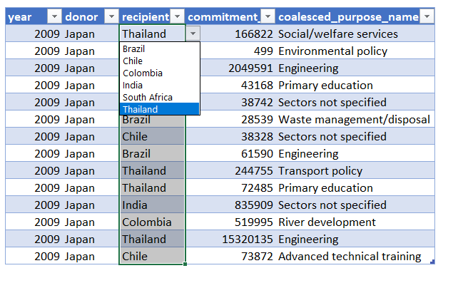
Using sort(unique) to create a dropdown menu
The relevant fields now show as dropdown menus.
Notes:
1: Ribbon Interface
Displays tab commands organized into groups. If you click the different tabs, you will see the commands change. Notice that some of the commands might be grayed out. This is because those commands are only usable in certain situations. The File tab, which opens Backstage view, is also included here.
2: Tabs
Groups of similar commands are organized under tab names. Click a tab to view the commands in the ribbon.
3: Quick Access Toolbar
As the name implies, the Quick Access toolbar gives you quick access to frequently used commands. This toolbar is completely customizable and can be positioned above or below the ribbon commands.
4: Name Box
Every cell has a name in the format “ColumnRow”. The name of the currently selected cell, called the active cell, is shown in the Name Box. In the sample image, the active cell is A1.
5: Formula Bar
The Formula Bar allows you to enter data in a cell. Data can be alphanumeric, pictures, symbols, or (as the name suggests) formulae.
6: Working Area
The data contained in the file will be shown here.
7: Worksheet Tabs
Every Excel file is properly referred to as a workbook. A workbook can contain one or more worksheets, just like an accounting ledger can contain one or more pages. Click these tabs to switch between the different worksheets.
8: Status Bar
This bar is used to display information about the workbook. Any running calculations will be shown here. There are also some zoom and view commands here.
9: Scroll Bars
As you grow more accustomed to working with Excel, you may begin to work on larger files. When all of the information in a worksheet will not fit on the screen, you can use these scroll bars to scroll horizontally or vertically through the data.

Slide 16
exercise
Work through the tasks in the Worksheet that accompanies this Module. Guidance and examples are in the Worksheet to help you.

Slide 17
ON THE OUTPUT SIDE, 1: Conditional Formatting

Slide 18
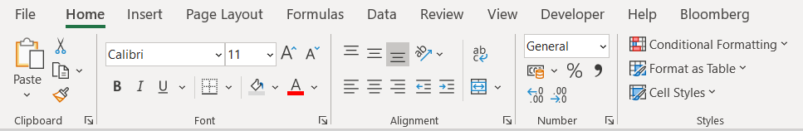
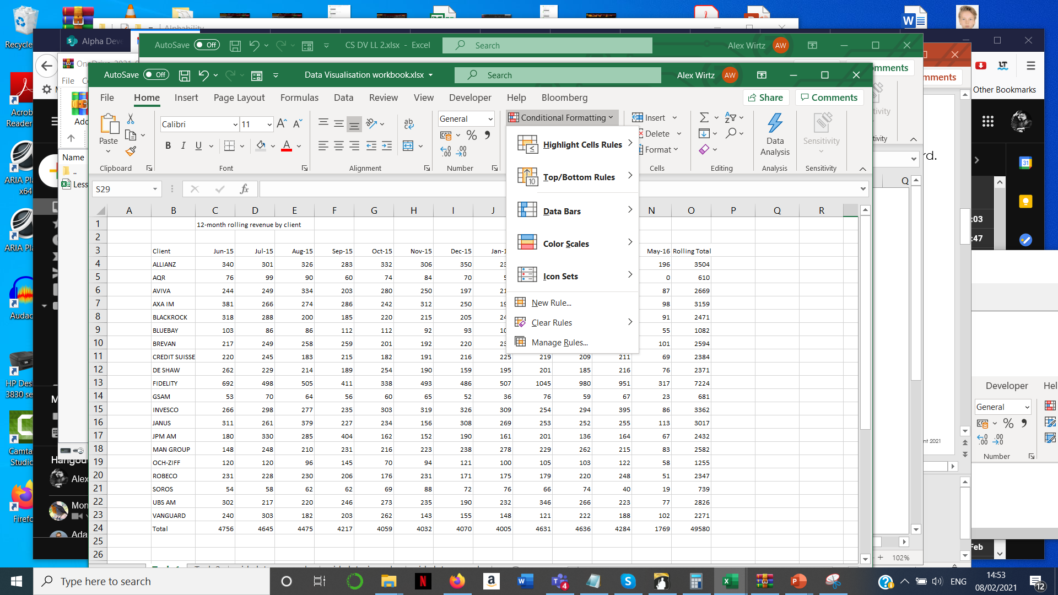
The conditional formatting wizard
1
Select the Home tab.
2
Select the Conditional Formatting Wizard.
3
Choose a rule from the rules wizard.

Slide 19
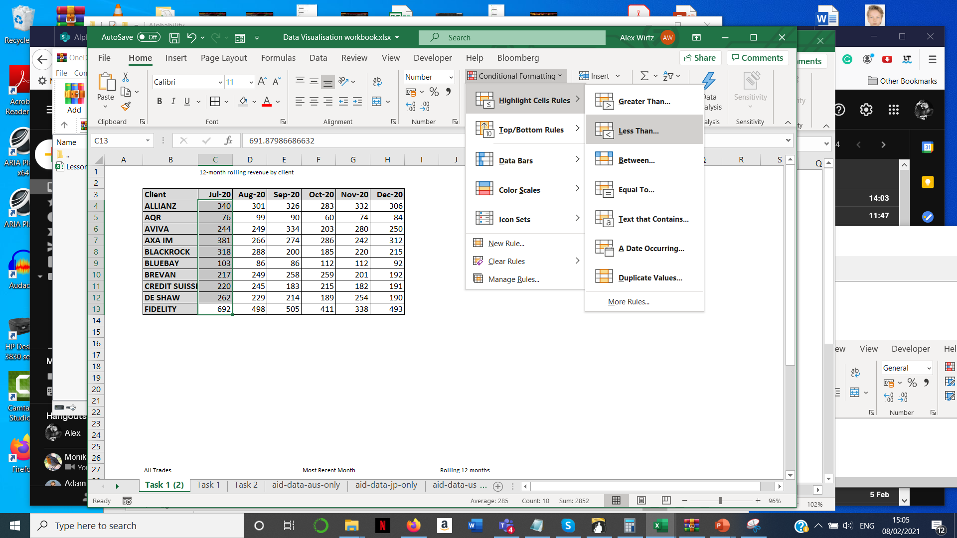
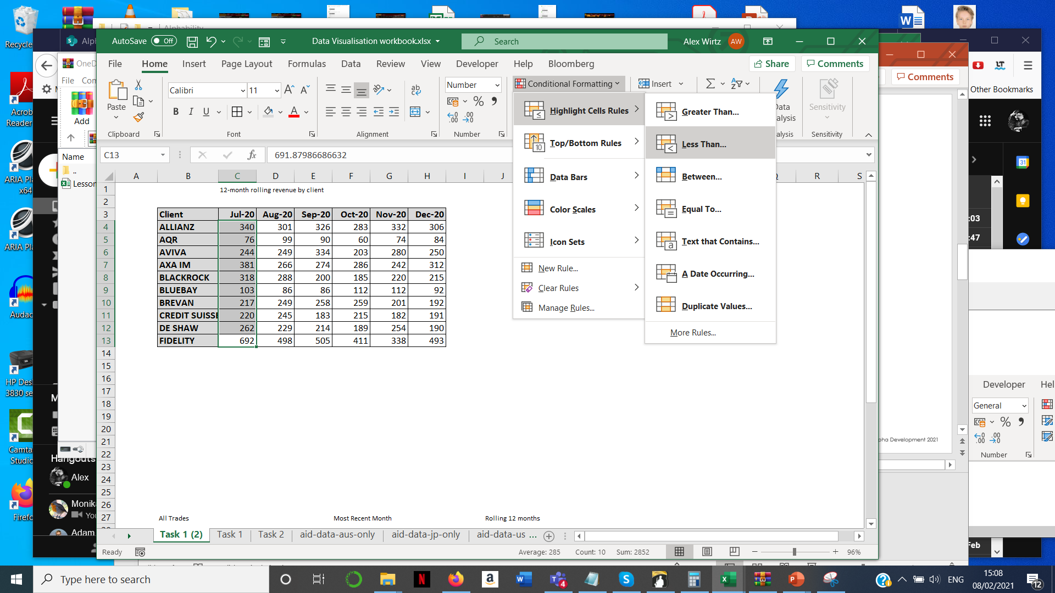
AN example
Your manager has a table of client revenue by month. They need to flag when clients deliver less than 100k of monthly revenue. Highlight these values.
1
Select the data range.
2
Select the formatting rule.

Slide 20
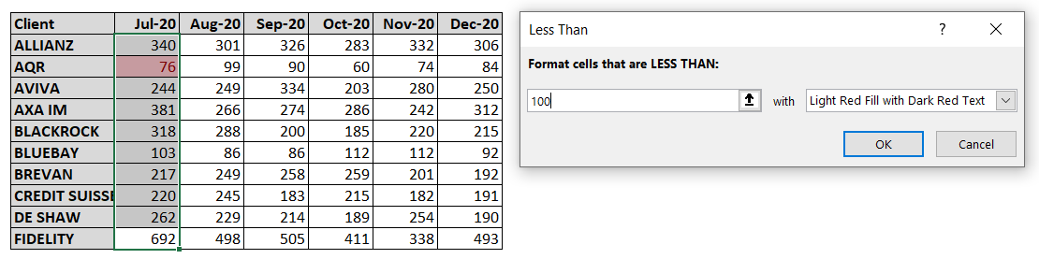
AN example
Your manager has a table of client revenue by month. They need to flag when clients deliver less than 100k of monthly revenue. Highlight these values.
3
Update the parameters in the wizard. You will see the rule applied in real time.

Slide 21
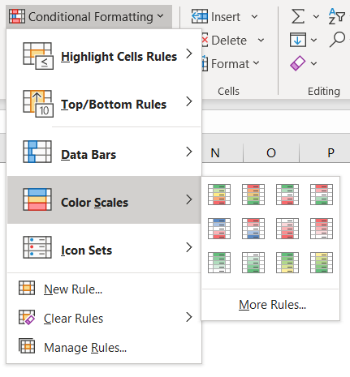
Focus on heatmaps
Heatmaps are excellent at highlighting outliers in data. But they need to be used with care.
1
Choose the Colour Scales option.
2
Choose a colour spectrum from the menu.

Slide 22
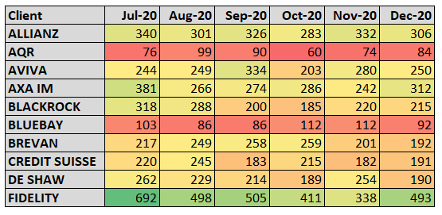
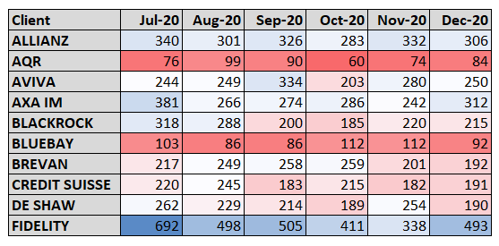
Focus on heatmaps
Which heatmap is better?
1
Green – yellow – red
2
Blue – white – red
Notes:
Definitely 2. The heatmap should foreground the outliers, not the middle-of-the-road values (which is what the yellow is doing in the first). Also, green/red differentiation is a problem for a significant proportion of users (approx. 8% men; 0.5% women). Newer GUI design takes this on board. Just don’t tell Bloomberg.

Slide 23
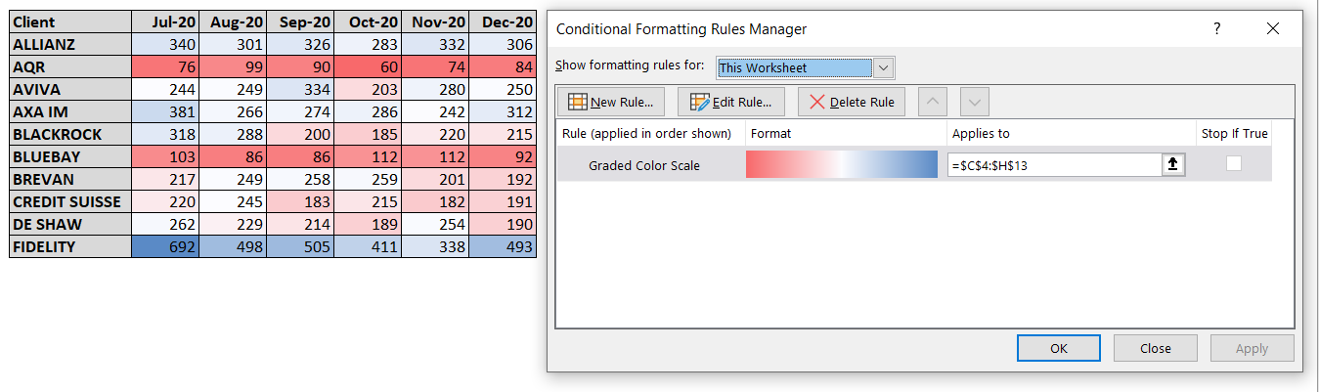
Managing formatting RULES
Changing, deleting, and other operations
1
Select the Manage Rules… menu item
2
Show the rules for your preferred scope

Slide 24
ON THE OUTPUT SIDE, 2: Sparklines AND MORE

Slide 25
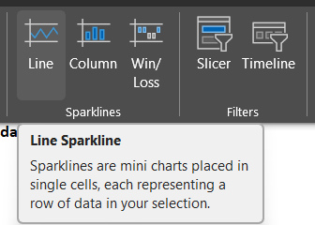
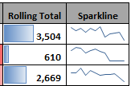
Sparklines AND MORE
Adding small visual representations to tabular data gives it greater impact without having to generate charts.
You can find the Sparklines option under the Insert tab on your ribbon.
This generates a small line chart of the data you have selected which can be added to the end of a row to summarise a trend.
Columns are a bar chart that can lie behind summary numbers.

Slide 26

EXERCISE
Please complete the Exercise in the spreadsheet that accompanies this Module.

